Slide 1

Democratizing personalization
Anne-Marie Kermarrec
Joint work with A. Boutet, D. Frey, R. Guerraoui, A. Jégou, H. Ribeiro

Slide 2





Need for personalization
KNN-based user-centric collaborative filtering
Notes:
----- Notes de la réunion (12/06/13 11:31) -----

Slide 3
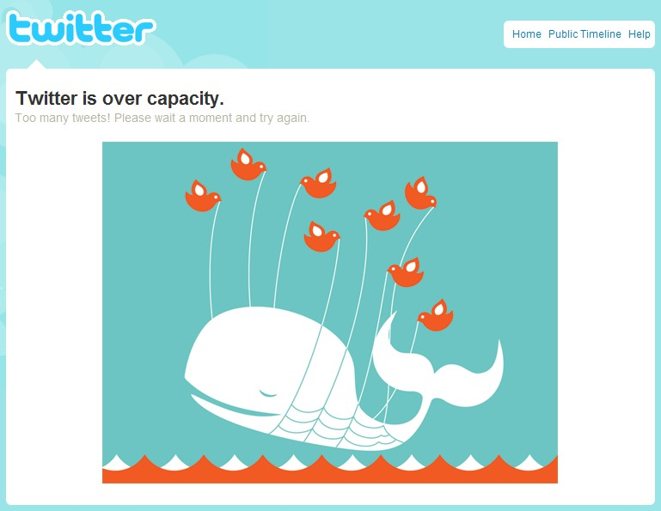
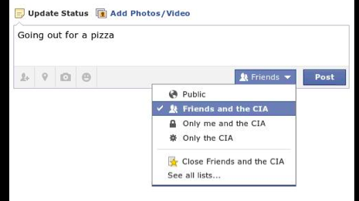
This talk
Providing scalable infrastructures involving the machines available at the edge of the network
Highly scalable
Cheap
Privacy
aware

Slide 4
Decentralized versus centralized KNN selection

Slide 5
Sampling-based KNN selection
Provide each user with her k closest neighbors
Use this topology for
personalized notifications: WhatsUp
recommendation: HyRec
Users owns a profile, the system has its favorite similarity metric

Slide 6





Decentralized KNN selection [FGKL 2010]
Ellie
Carl
clustering layer gossip-based topology clustering
Bob
Dave
Alice
Carl
Ellie
Bob
RPS layer providing random sampling
Dave
Alice
Random link
Social link
node
Local version portable to centralized systems
[Dong & al, 2011]

Slide 7
Data structures
@IP:port | 132.154.8.5:2020
Bloom Filter | 010111011001
Profile | I like it: : N_{1,} N_{2,} … I don’t : N₁₀, N_{13, …}
Update time | 5
@IP:port | 132.154.8.5:2020
Bloom Filter | 010111011001
Profile | I like it: : N_{1,} N_{2,} … I don’t : N₁₀, N_{13, …}
Update time | 5
Network
of the k
closest entries
@IP:port | 132.154.8.5:2020
Bloom Filter | 010111011001
Profile | I like it: : N_{1,} N_{2,} … I don’t : N₁₀, N_{13, …}
Update time | 5
@IP:port | 132.154.8.5:2020
Bloom Filter | 010111011001
Profile | I like it: : N_{1,} N_{2,} … I don’t : N₁₀, N_{13, …}
Update time | 5
@IP:port | 132.154.8.5:2020
Bloom Filter | 010111011001
Profile | +: N_{1,} N_{2,} … - : N₁₀, N_{13, …}
Update time | 5
Uniform (dynamic)
sample of c
random entries
@IP: port | 102.14.18.1:2110
Bloom Filter | 100100000110
Update time | 30
@IP: port | 102.14.18.1:2110
Bloom Filter | 100100000110
Update time | 30
@IP: port | 102.14.18.1:2110
Bloom Filter | 100100000110
Update time | 30
@IP: port | 102.14.18.1:2110
Bloom Filter | 100100000110
Update time | 30
@IP: port | 102.14.18.1:2110
Bloom Filter | 100100000110
Update time | 30
@IP: port | 102.14.18.1:2110
Bloom Filter | 100100000110
Update time | 30
@IP: port | 102.14.18.1:2110
Bloom Filter | 100100000110
Update time | 30

Slide 8

Localized KNN in centralized settings
[Dong & al, WWW 2011]
Frank
Carl
Alice
Bob
Ellie
Dave

Slide 9
WHATSUP DECENTRALIZED NEWS RECOMMENDER [bFGJK, 2013]

Slide 10
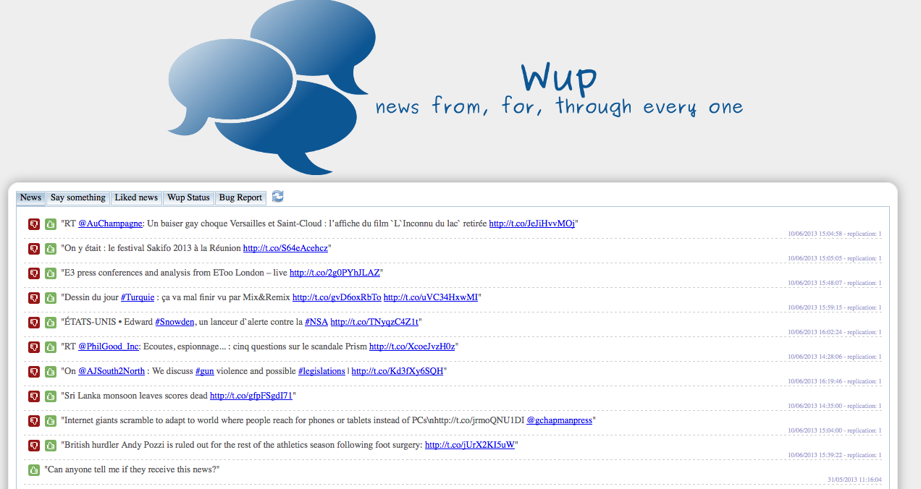
An implicit notification system
based on collaborative filtering

Slide 11
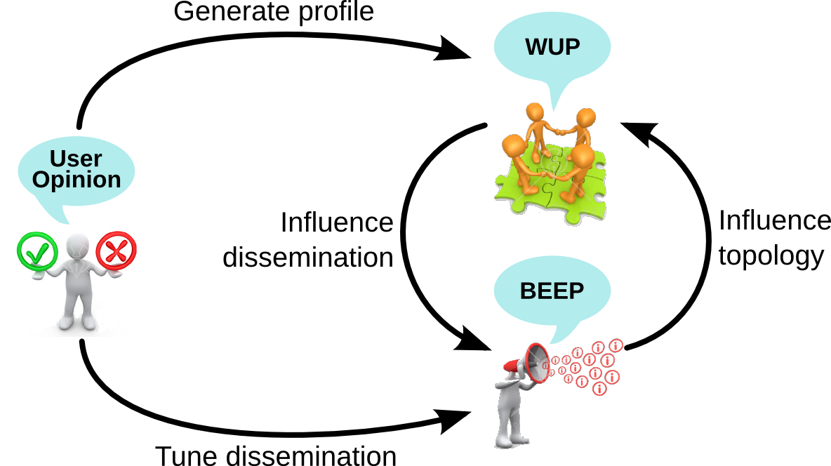
WhatsUp in a nutshell
KNN selection
Dissemination

Slide 12

Dissemination: orientation and amplification
Orientation: to whom?
Amplification: to how many?
Exploit: Forward
To friends
Explore: Forward to
random users
Increase
Fanout
(Log(n))
Decrease
Fanout
(1)

Slide 13
Evaluation
User metrics: Recall-Precision
System metrics: Number of messages-Redundancy
Traces
  Real trace from a 480 user survey on 1000 news items
  Delicious and Digg crawls
Notes:
Recall= number of users reached interested over number od users interested
Precision= nber of users reached interested over number of users reached

Slide 14
WhatsUp in action on the survey
 | Precision | Recall | Redundancy | Messages
Gossip | 0.34 | 0.99 | 0.85 | 2.3 M
Cosine-CF | 0.64 | 0.12 | 0.27 | 30k
Whatsup | 0.53 | 0.78 | 0.28 | 280k

Slide 15

Privacy matters
Obfuscation
Does not reveal the exact profile
Does not reveal the least sensitive information
Randomized dissemination
Avoids predictive nature of the dissemination
Flips the opinion with a given probability

Slide 16
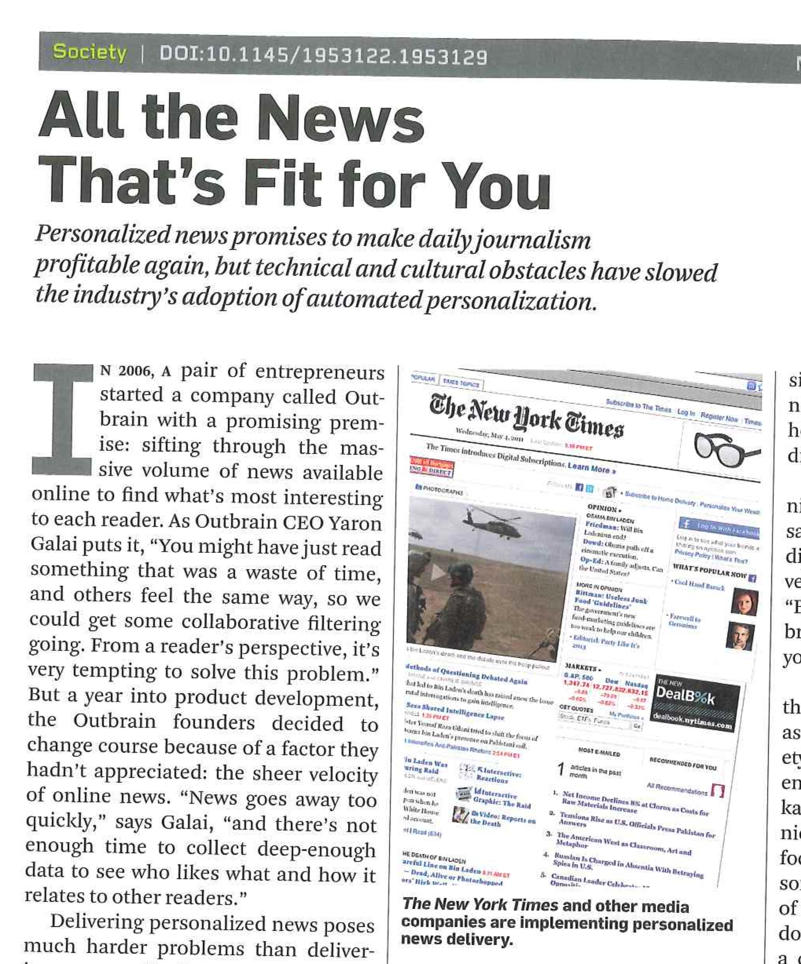

Obfuscation
Obfuscated
profile
Private
profile
News item
profile
Filter
profile
I like it
+
Compact
profile
+
User Profile
exchanged
during gossip
News item
profile
Notes:
The compact profile provides a summary of node n ’s
interests. The filter profile captures the main interest
trends among the nodes that are similar to n . Finally,
the obfuscated profile provides a filtered version of
n ’s compact profile containing only the least senstitive
information. Nodes do not strictly maintain the compact ,
filter , and obfuscated profiles : they are computed when
needed, using the information from the private and item
profiles
Obfuscated Profiles: A node computes its obfuscated
profile whenever it needs to exchange it with other
nodes as part of the clustering protocol. As shown in
Figure 1, it achieves this by filtering the contents of
its compact profile using its filter profile: this yields
a bit vector that captures the most popular bits in the
node’s community and thus hides its most specific and
unique tastes. The fine-grained information contained in
the node’s private and compact profiles remains instead
secret throughout the system’s operation

Slide 17
Impact of obfuscation
Privacy-unaware WhatsUp
WhatsUp
Fanout

Slide 18
HyRec: a Hybrid Recommender System

Slide 19
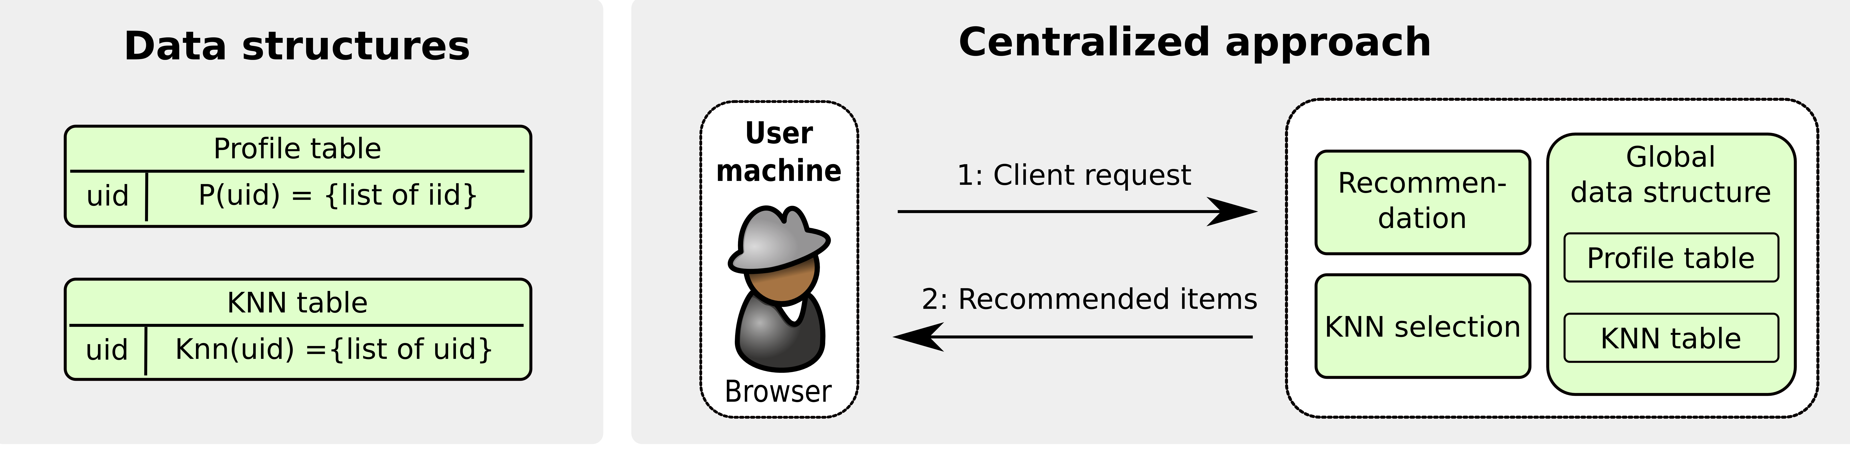
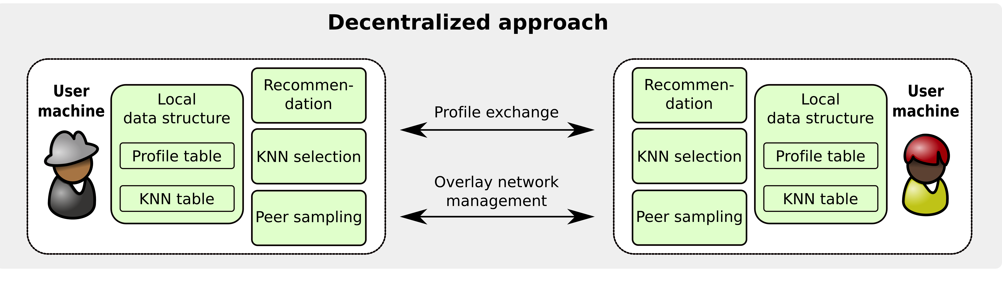
Taking the best of both worlds

Slide 20
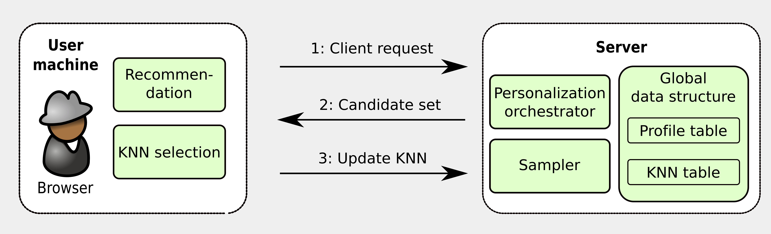
HyRec: Hybrid architecture
Candidate set (k) : k neighbors and their k neighbors + k random nodes
Online KNN selection
No data stored at the client

Slide 21
Experiments
Dataset | Users | Items | Ratings
MovieLens1 (ML1) | 943 | 1700 movies | 100,000
MovieLens2 (ML2) | 6,040 | 4000 movies | 1,000,000
MovieLens3 (ML3) | 69,878 | 10,000 movies | 10,000,000
Digg | 59,167 | 7724 items | 782,807
k= 10, offline KNN selection for centralized

Slide 22
Quality of the recommendation (MovieLens)

Slide 23
Cost

Slide 24
HyRec versus the client load
Impact of HyRec
Impact of the client load

Slide 25
HyRec versus a centralized recommender
Impact of the profile size
Impact of the request stress

Slide 26
To take away
Personalization is crucial (and still in its infancy)
Distributed solutions attractive for privacy and scalability

Slide 27

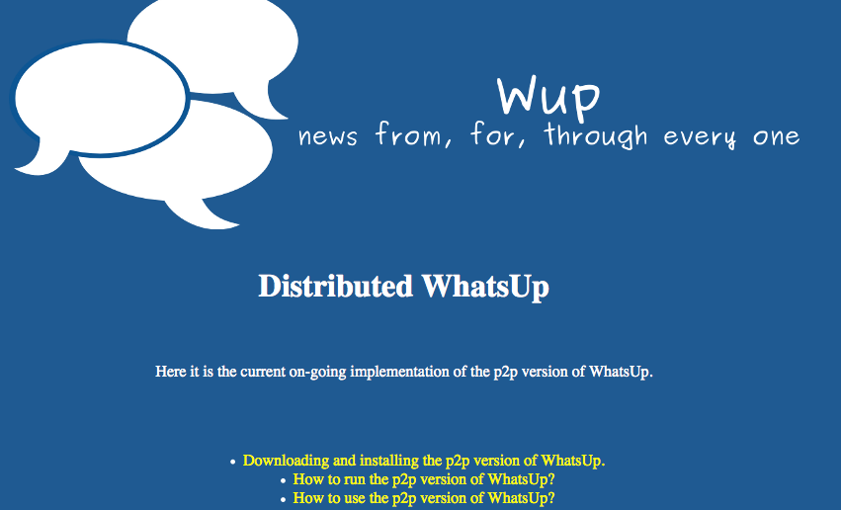
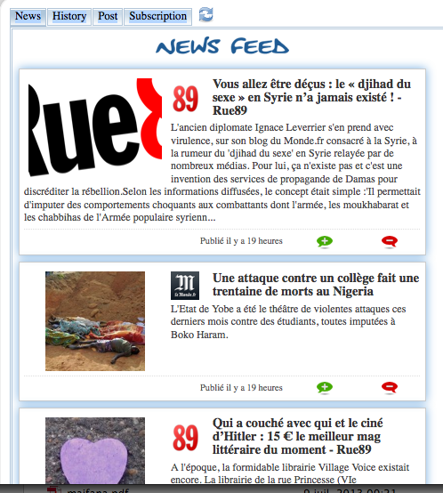
Thank you
TRY NOW
    http://gossple1.irisa.fr/dashboard/
http://131.254.213.98:8080/wup/
www.gossple.fr

